Slide 1
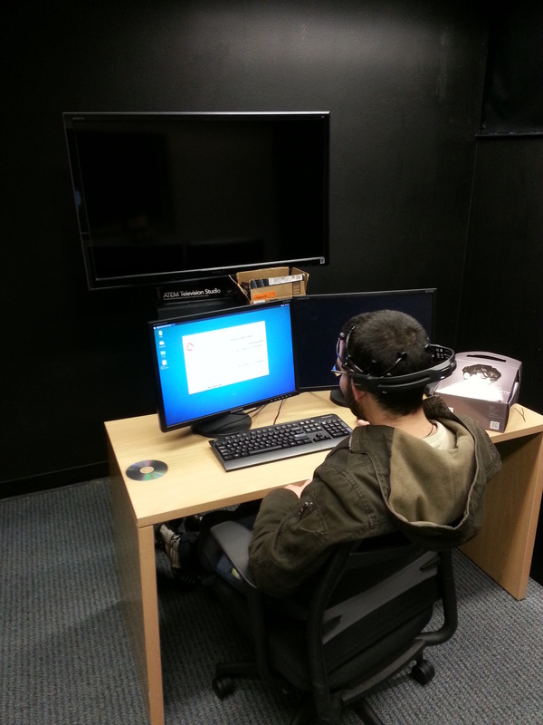
What is the Experience Lab?
Real-time multimodal (multiple signals) data collection platform for human signals
PPG (heart rate + variability)
Skin conductance
Face camera
EEG (brain activity)
Mouse and keyboard usage
Useful for research studies involving people interacting with a computer

Slide 2
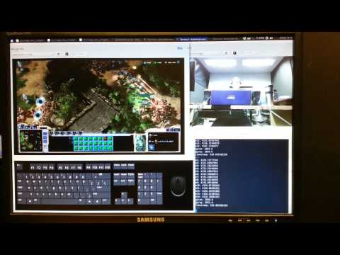
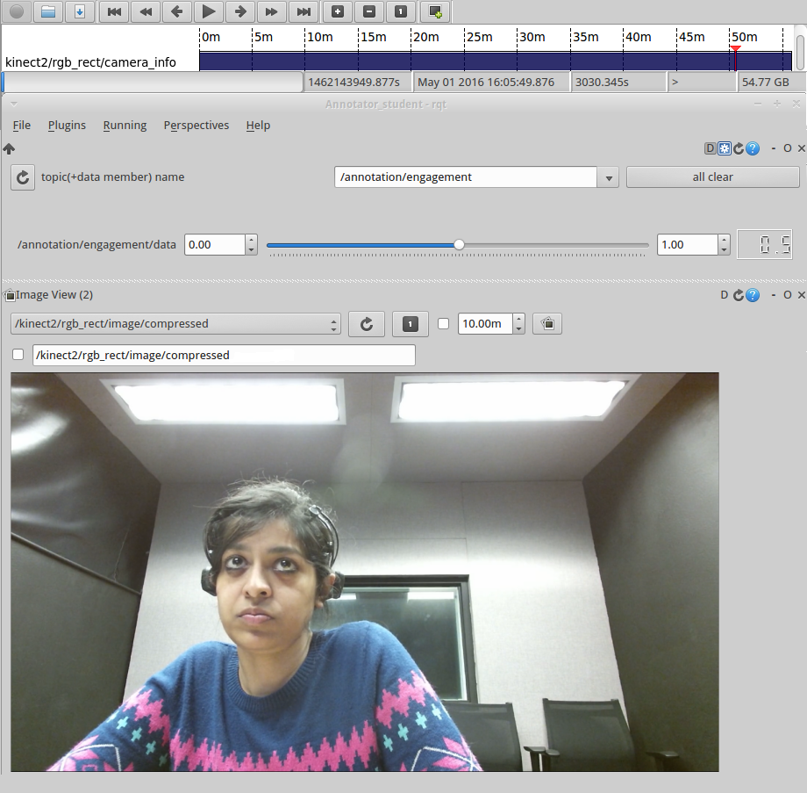
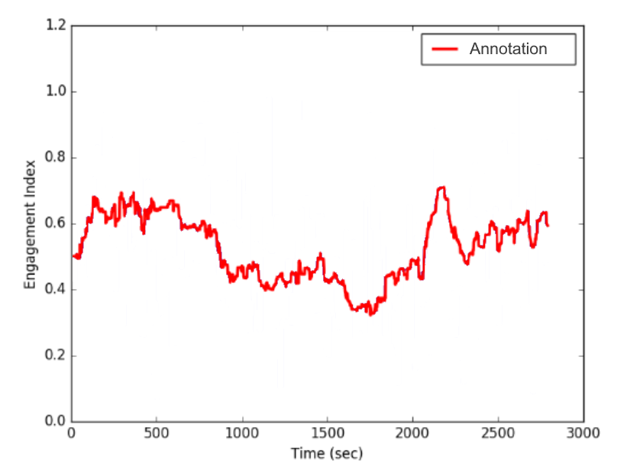
“Data Collection Mode”
“Annotation Mode”

Slide 3
Data Collection Mode
Is fed data streams from inputs (KB/mouse, screen and audio capture, HDMI camera input, EEG (not used at the moment), etc.)
Records inputs to a ‘timeline’ for later analysis
This end product is called a bag
Main issue: How does the software handle “dropped packets”? What if one of the data inputs’ buffer overflows? Does this throw off the timeline’s synchronization?

Slide 4
Annotation mode
Replays that timeline in real-time, and allows a user to ‘annotate’ using various inputs.
For example: they could move a slider up and down according to the subject’s apparent ‘engagement’ as evident in the facecam feed
Main issue: Same as data collection mode; how accurately is this annotation feed spliced onto the rest of the timeline?

Slide 5
Tasks for the next sprint.
Modernize the platform using latest libraries
Possibly switch to ROS 2, as it appears to have many fixes we desire
Test data collection mode
Do timestamps of sensor data packets align?
Test annotation mode
Do annotations align with collected data?
Improve usability, specifically around annotation mode, as the main users of this program may not be very computer savvy. Make the program as approachable as possible to anyone wanting to use it for research.

